Slide 1
G440/540 Terrestrial Ecosystem Modeling Agriculture, Land Cover Change and Land Management in TEMs*
Instructor: Dr Natasha MacBean

Slide 2
Overview
Crop models
Agricultural processes in TEMs
AgMIP and the Global Gridded Crop Model Intercomparison
Prescribing land cover change in TEMs
Land management developments in TEMs

Slide 3
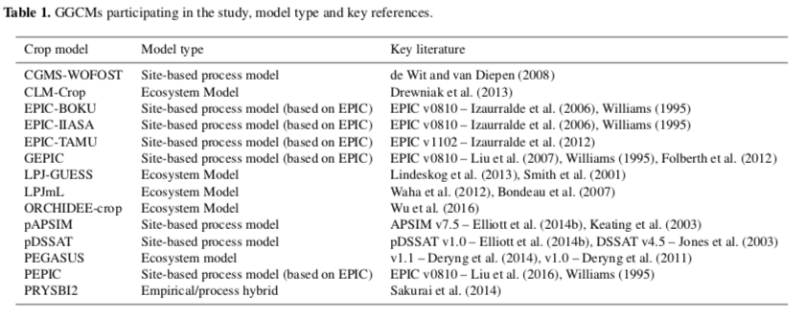
Global Crop Models
Two kinds*:
1. Developed from a site-based process model
2. Modified global TEM to account for field-scale crop model processes and parameters
Müller et al. (2017)
Notes:
Site-based process model contain a much wider variety of management options. They still have built in C cycle, nutrient deposition/limitations, hydrology and soil erosion (in the case of EPIC)

Slide 4
Agricultural processes in TEMs
Initially global TEMs like ORCHIDEE, CLM had unmanaged C3 and C4 crops
Now have managed agriculture → e.g. irrigation, addition of fertilizer
Predict yield for four main crop varieties (wheat, maize, rice and soybean)
Mechanistic: crop growth and yield still based on biophysics and biogeochemistry as in non-agricultural part of TEMs, but
Planting/sowing and harvest dates are an input OR specific planting rules that mimic human decision making
Maturity defined based on crop-specific temperature requirements
Specific parameters for crop PFTs (e.g. maximum LAI)
Management options
Notes:
Addition of fertilizer etc still may be very generally applied across large regions (lack of more spatially distributed data)
Important to model correctly because crops cover ~12% of land surface

Slide 5
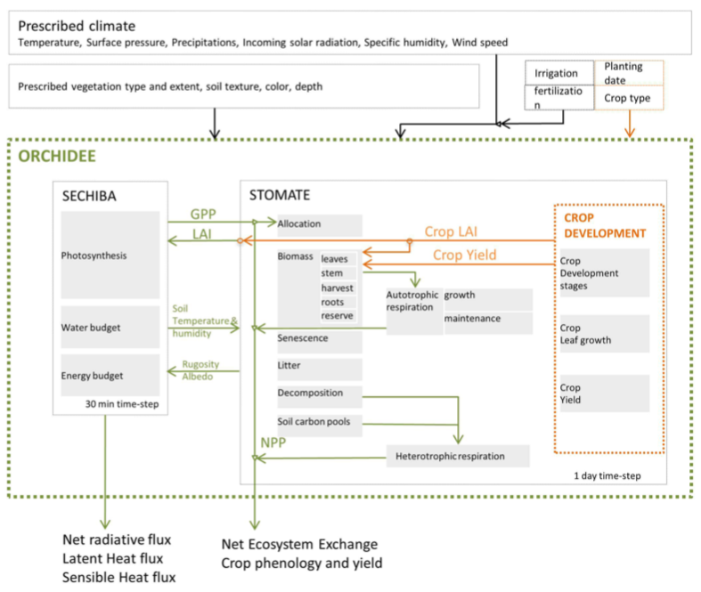
ORCHIDEE-CROP
Specific crop phenologies
Harvest module
N fertilizer
Allocation modified for grain yield
Wu et al. (2016); Wang et al. (2017); originally STICS Agronomy model

Slide 6
Global crop model issues: model related
Complexity of management decisions not fully implemented
Management systems not documented well everywhere → hard to implement what you don’t know!
Crop growth heavily based on climate → assumes crops well adapted to climate
Assume static management practices and soil properties
Temporal dynamics driven by climate and CO₂ alone
Limited crop varieties → assumed to be homogenous globally
Static or regionally-specific crop parameterizations (too general)
Too idealized representation of crops and agricultural practices
Incomplete coupling between crop model and regular TEM processes

Slide 7
Global crop model issues: data related
Field scale calibration not possible
Hard to find data at larger spatial scales
Initialization of soil properties is hard (e.g. nutrient rich or poor)
Limited data on irrigation timing, duration, amount, area
Limited data on growing seasons/planting dates
Crop-specific parameters hard to find
Different cropping rotation practices
Rely on (sub-)National datasets (not gridded)
Generally only timeseries of yield data available (no other variables throughout season)
Main points:
lack of data → hard to parameterize models and hard to benchmark
Hard to compare models and data
Müller et al. (2017)
Notes:
Issues in simulations with multiple growing seasons in one calendar year and how that can be matched to how yields are reported to the FAO.
Interpolation issues when interpolating from national statistics to gridded datasets
Also issues if production reported falls over two calendar years (as in the case in SH for example). That estimate can then be put in one calendar year or another.

Slide 8

Global Gridded Crop Model Intercomparison
Part of AgMIP (https://agmip.org)

Slide 9
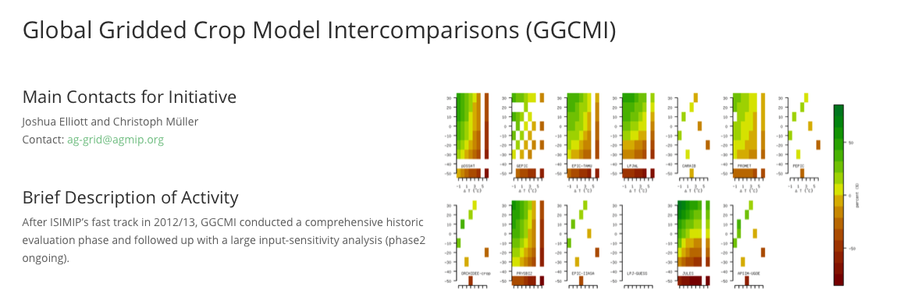
Global Gridded Crop Model Intercomparison
https://agmip.org/aggrid-ggcmi/
AIM: assess model performance across range of crop models and to identify improvements needed
Müller et al. (2017; 2019)

Slide 10
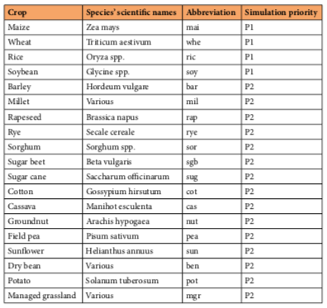
Global Gridded Crop Model Intercomparison
Phase 1: predicted yield of four main crops (plus many additional)
Müller et al. (2017; 2019)

Slide 11
Global Gridded Crop Model Intercomparison
1st phase → 3 sets of experiments:
“default”: Model’s own parameterizations and assumptions
“fullharm”: Harmonized growing seasons (i.e., with supplied planting and harvest dates) and fertilizer inputs
“harm-suffN”: harmonized growing seasons but assuming the absence of nutrient limitation
Also rain-fed “noirr” vs full irrigation “firr”
Limited input data (weather, soil data and N fertilizer)
Cropping calendars come from: FAO statistics
Because of data and model-data comparison issues, focus on:
national to global yield estimates,
temporal variability,
Spatial variability related to environmental gradients and fertilizer inputs
Higher weight to highly productive areas
Better than statistical models, but limited predictive power in regions driven more by management/pest control than weather variability.
Müller et al. (2017; 2019)
Notes:
Note that full irrigation does not necessarily mean that the models were never water stressed – depends on individual models.
No other management (e.g. pest control, phosphorus fertilizer etc) were input because not all models can simulate complexity of management decisions.

Slide 12
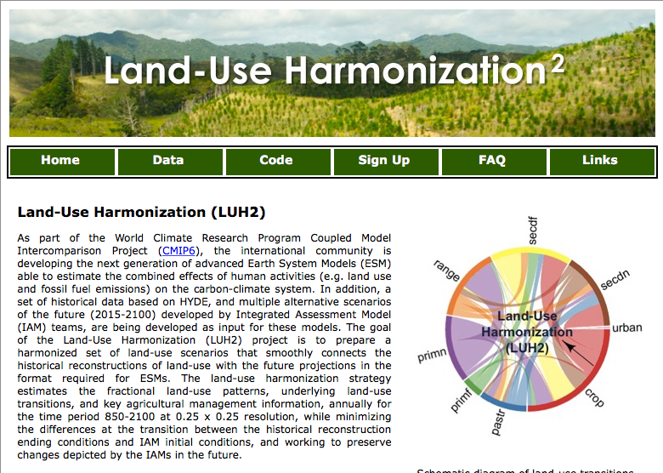
Land Cover Change in TEMs
Most models in CMIP5/6 use the Land Use Harmonization (LUH) dataset to prescribe land use/cover changes from 850 to 2100: https://luh.umd.edu/index.shtml, which uses a global land-use model
Based on:
Historical maps of land use from the HYDE database (Klein Goldewijk et al., 2017) mostly cropland and pasture:
Historical estimates and census data
National and FAO statistics
Current satellite-derived land cover
Historical national statistics of wood harvest (constrained by satellite “tree loss” data)
Historical distributions of C stocks and biomass density
Future land use and cover change from IAMs
Hurtt et al. (2011)

Slide 13
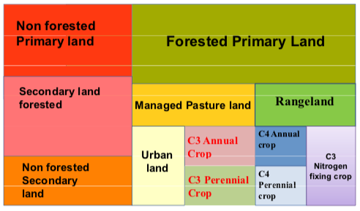
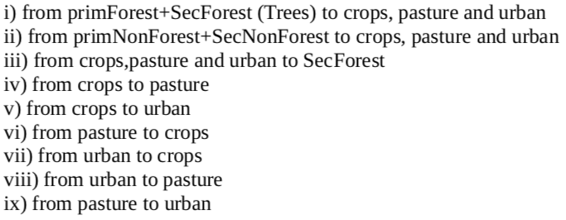
Land Cover Change in TEMs
Note: Doesn’t match PFTs!
Land use states in LUH
In ORCHIDEE:
Current day: impose “anthropogenic area” (human managed/farmed areas) from LUH
Natural vegetation from original PFT map derived from ESA LC map → expand or reduce forests and natural grasslands proportionately
Year-to-year backwards construction using the LUH “transition matrix”
Also run forward for future scenarios
Land use transitions in LUH
Everything subject to subjective decisions → therefore uncertainty!
Notes:
“DGVMs implement land use change differently (e.g. an increased cropland fraction in a grid cell can either be at the expense of either grassland or shrubs, or forest, the latter resulting in deforestation; land cover fractions of the non-agricultural land differ between models). Similarly, model-specific assumptions are applied to convert deforested biomass or deforested area and other forest product pools into carbon, and different choices are made regarding the al- location of rangelands as natural vegetation or pastures.” (Friedlingstein et al., 2019; Global Carbon Budget 2019)

Slide 14
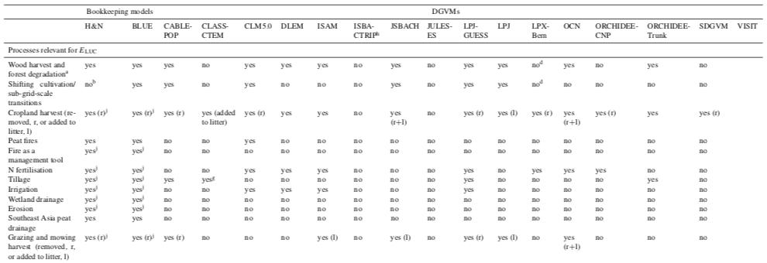
Land Cover Change in TEMs
E_{LUC}
Everything subject to subjective decisions → therefore uncertainty!
Friedlingstein et al. (2019); Global Carbon Budget 201 9
Notes:
“DGVMs implement land use change differently (e.g. an increased cropland fraction in a grid cell can either be at the expense of either grassland or shrubs, or forest, the latter resulting in deforestation; land cover fractions of the non-agricultural land differ between models). Similarly, model-specific assumptions are applied to convert deforested biomass or deforested area and other forest product pools into carbon, and different choices are made regarding the al- location of rangelands as natural vegetation or pastures.” (Friedlingstein et al., 2019; Global Carbon Budget 2019)

Slide 15
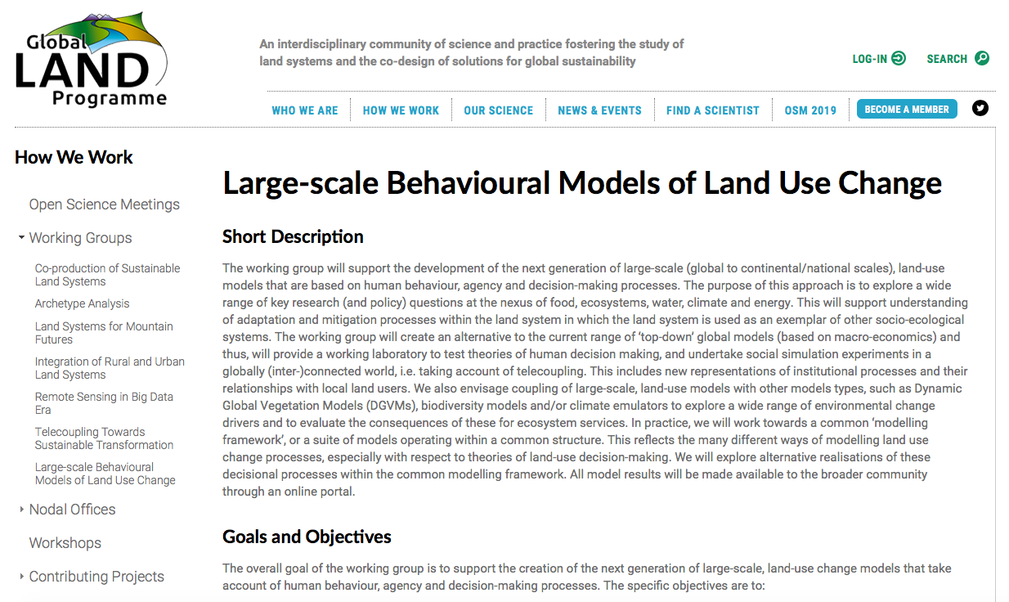
Socio-economic land use modeling
https://glp.earth/how-we-work/working-groups/large-scale-behavioural-models-land-use-change

Slide 16
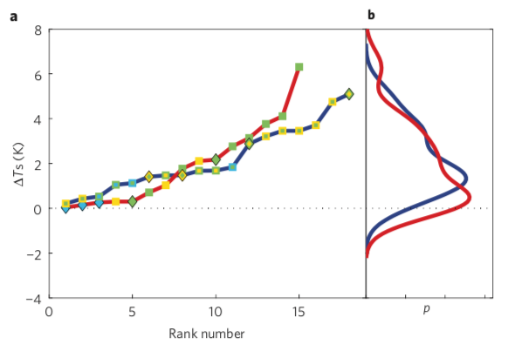
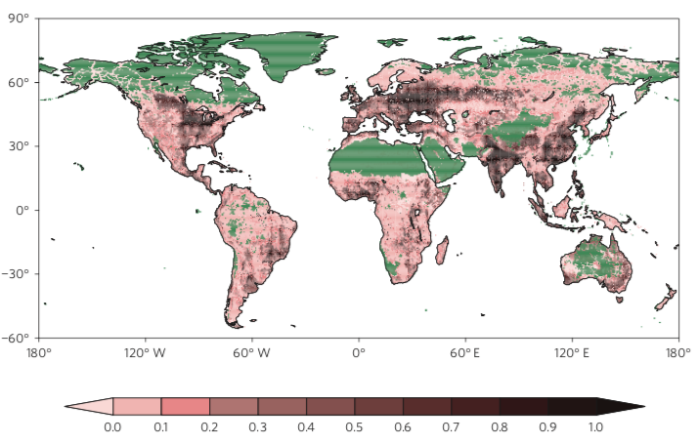
Need for Land Management in TEMs
Land use change or cover change (LULCC) → clear impact on vegetation, carbon, water.
Land management (no LULCC) → ignored for a while, until…
LCC
LM
Land affected by management
Ranking based on magnitude of change effect
Luyssaert et al. (2014)

Slide 17
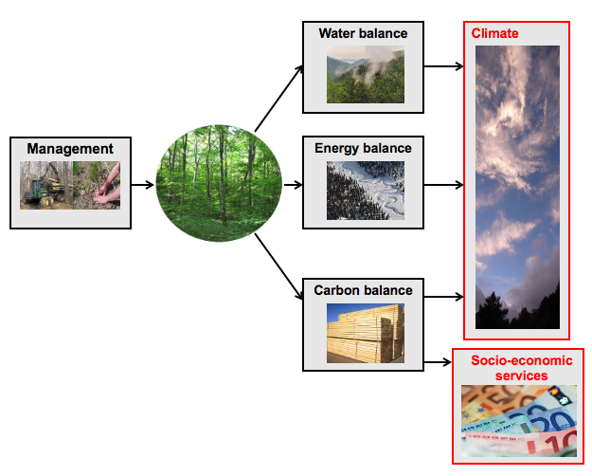
Need for Forest Management in TEMs
Luyssaert, S. ERC DOFOCO Grant: https://cordis.europa.eu/project/id/242564; https://forge.ipsl.jussieu.fr/orchidee/wiki/DevelopmentActivities/ORCHIDEE-DOFOCO

Slide 18
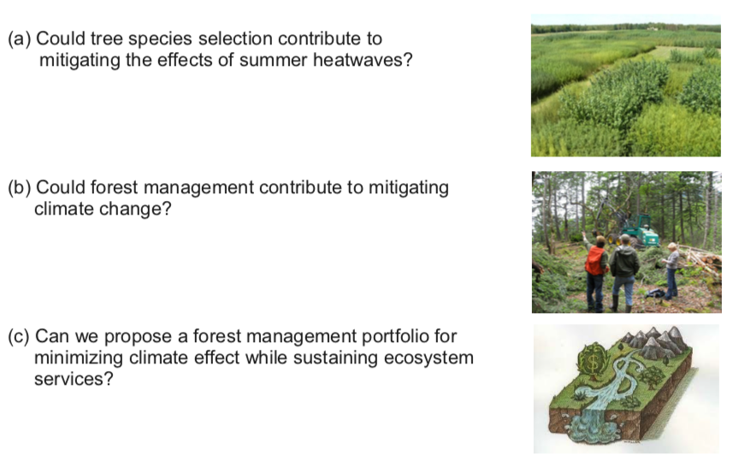
Forest Management Research Questions
Luyssaert, S. ERC DOFOCO Grant: https://cordis.europa.eu/project/id/242564

Slide 19
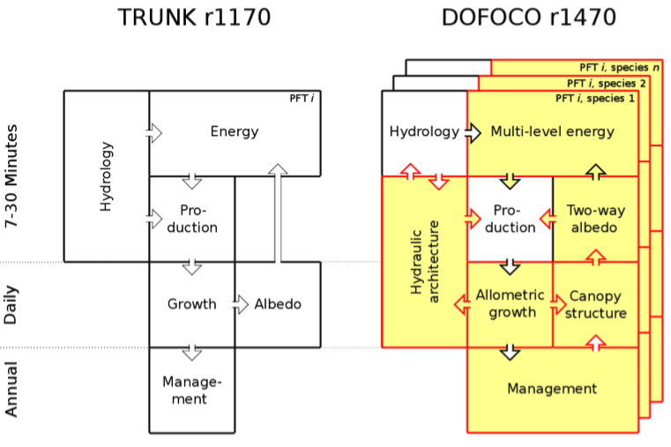
Changes needed to address forest management
Not only management decisions needed, but much better representation of forest canopies → ORCHIDEE-CAN version
Naudts et al. (2015)

Slide 20
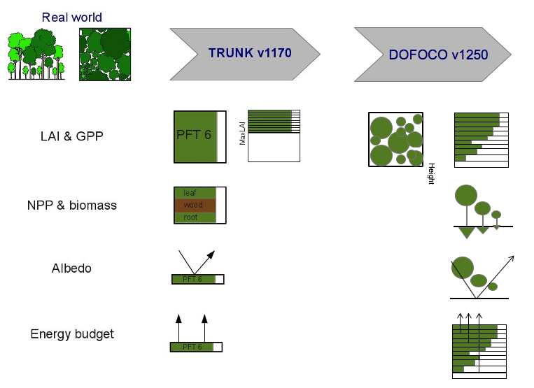
Changes needed to address forest management
Naudts et al. (2015)

Slide 21
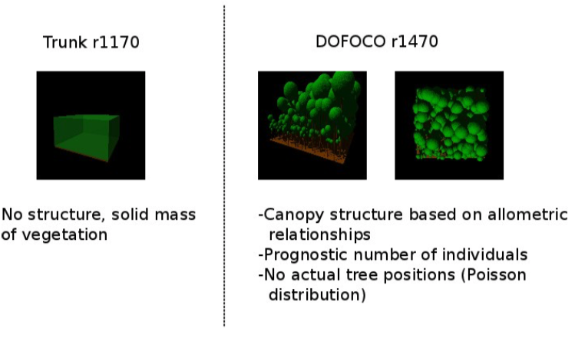
Changes needed to address forest management: canopy structure
-Gaps between trees
Naudts et al. (2015)

Slide 22
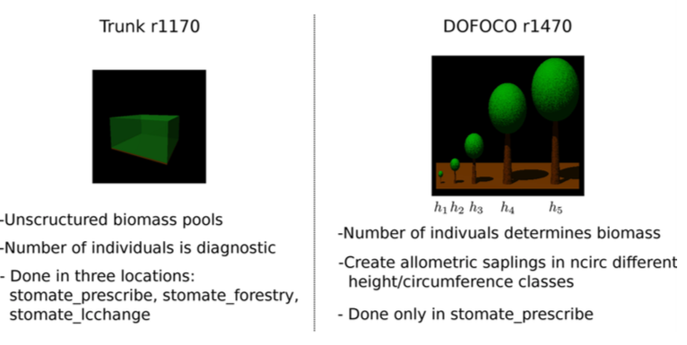
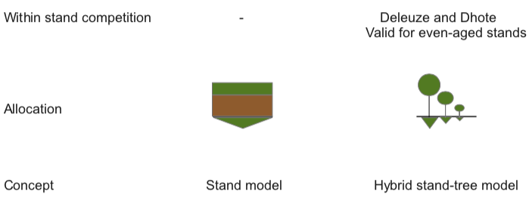
Changes needed to address forest management: allocation
Naudts et al. (2015)

Slide 23
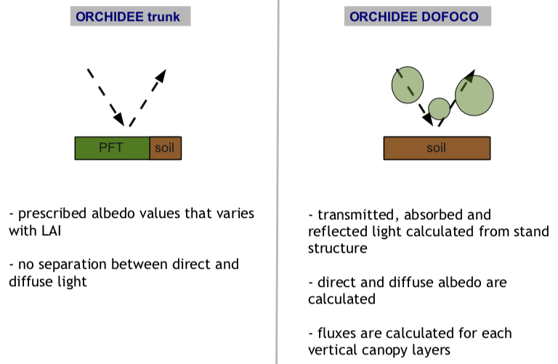
Changes needed to address forest management: albedo calculation
Naudts et al. (2015)

Slide 24
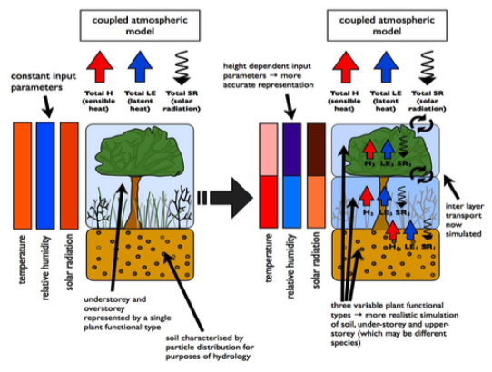
Changes needed to address forest management: Multi-layer energy within the canopy
Ryder et al. (2016)

Slide 25
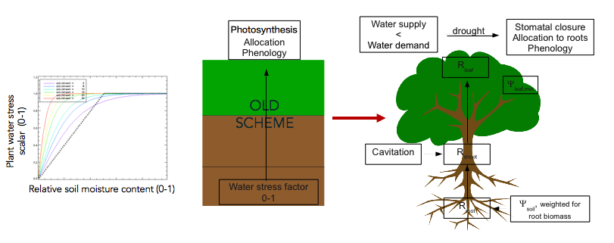
Changes needed to address forest management: Plant hydraulics
Either empirical function (water-limiting scalar between 0 and 1) based on soil moisture → limits photosynthesis and/or evapotranspiration
OR mechanistic process describing flow of moisture based on difference in matric potential between root zone and leaves and resistances to moisture flow
→ Empirical water stress limitation factor
→ Mechanistic coupling between plant carbon and water cycles
De Kauwe et al. (2015) → empirical plant water stress functions in TBMs don’t capture drought well
Naudts et al. (2015)

Slide 26
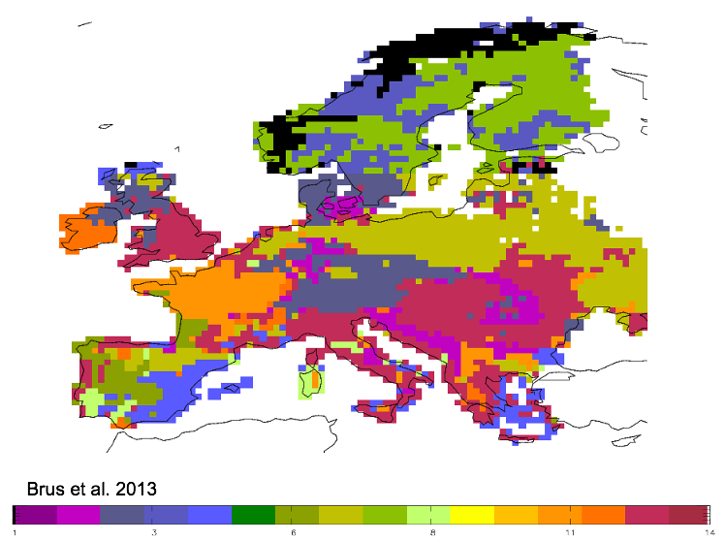
Changes needed to address forest management: Species vs PFTs
Need species level (not PFT), therefore need:
Species maps (not easy to obtain!)
And associated species-level parameters…

Slide 27
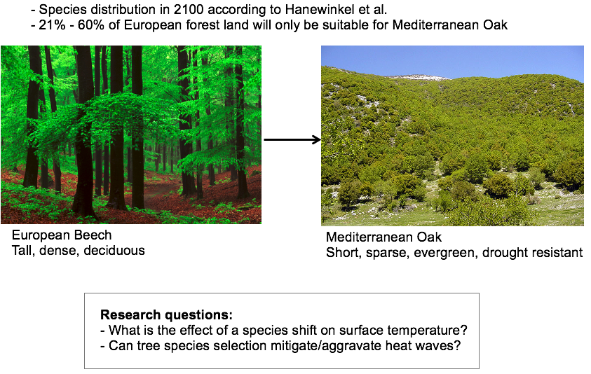
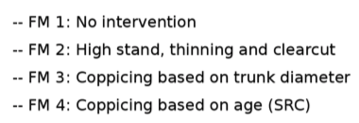
Forest management decisions now possible
Questions of mitigation and adaptation…

Slide 28
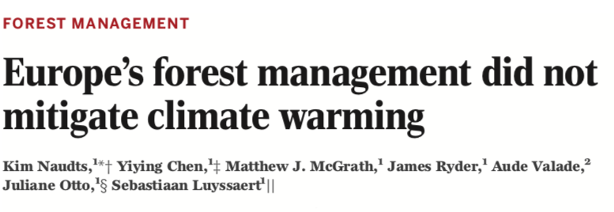
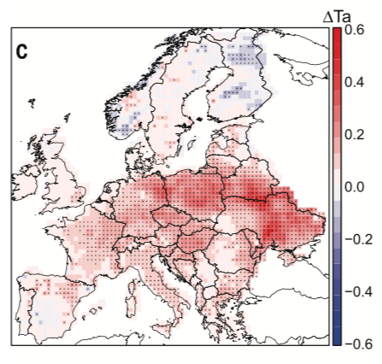
Did 20th Century European Forest Management cool the climate?
Naudts et al. (2016)

Slide 29
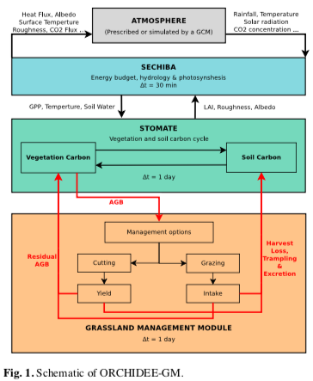
Grassland Management in ORCHIDEE
Cutting, grazing and N fertilization
Animal processes and management options coupled to normal carbon, water, energy processes
Management can be user set or optimized in model
Chang et al. (2013): originally PaSim model (Vuichard et al., 2007a,b)
Notes:
Cutting: fraction of shoot biomass is removed and remaining root biomass is left.

Slide 30
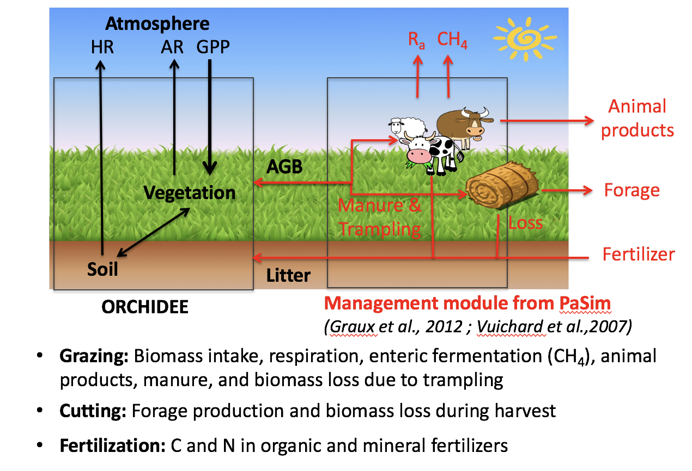
Grassland Management in ORCHIDEE
Animals removed from paddock when biomass < 300kgDMm⁻²
Chang et al. (2013): originally PaSim model (Vuichard et al., 2007a,b)
Notes:
Cutting: fraction of shoot biomass is removed and remaining root biomass is left.

Slide 31
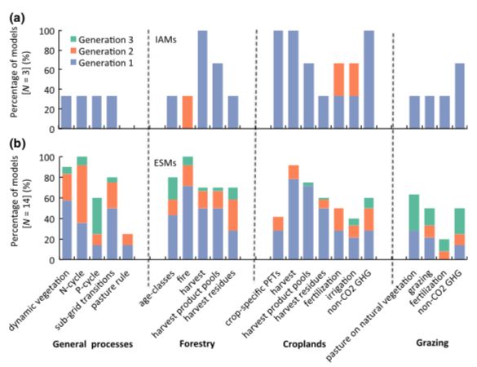
Current status of land management in TEMs
Pongratz et al (2017) AIM: “To guide the prioritization of implementation, we evaluate ten land management practices—forestry harvest, tree species selection, grazing and mowing harvest, crop harvest, crop species selection, irrigation, wetland drainage, fertilization, tillage, and fire—for (1) their importance on the Earth system, (2) the possibility of implementing them in state-of-the-art ESMs, and (3) availability of required input data.”
Notes:
Generation 1: present use; 2: current development; 3: plans for the future after CMIP6

Slide 32
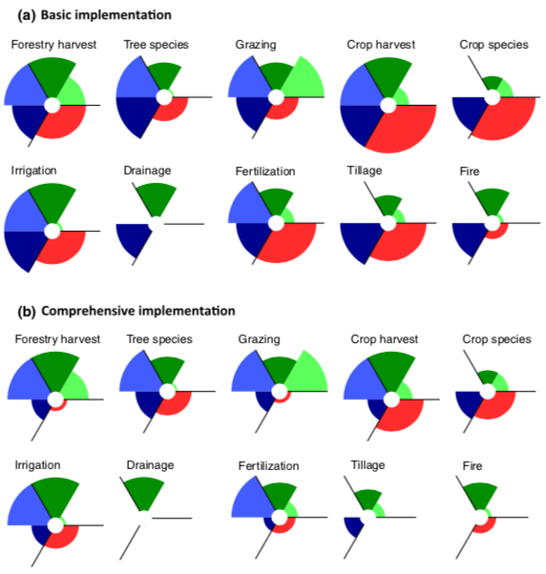
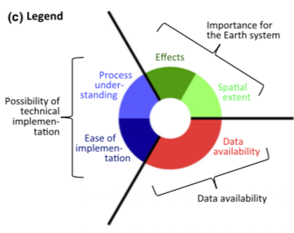
Current status of land management in TEMs
Pongratz et al. (2017)

